Slide 1
DAT 500S Module 7
Quiz:
Exercise 8.4: Problems 1, 3, & 4
Group Assignment:
Exercise 8.4: Problem 9
Individual Assignment:
Exercise 8.4: Problem 8 (parts a, b, & c)

Slide 2
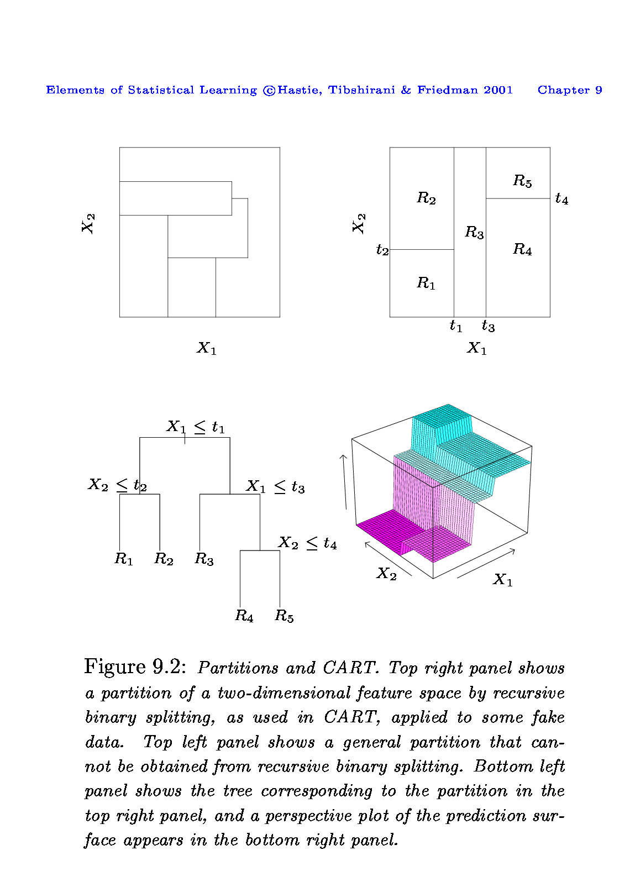
Module 7 - Tree
When we create partitions this way we can always represent them using a tree structure.
This provides a very simple way to explain the model to a non-expert i.e. your boss!

Slide 3
Module 7 - Tree
Where to split? i.e. how do we decide on what regions to use i.e. R₁, R₂,…,R_{k} or equivalently what tree structure should we use?
What values should we use for ?

Slide 4
Common Problems in Individual Assignment 6
When the question does not require training and test split, some students split them into training and test. However, the problem comes when they compare the results from Lasso using training data and the whole dataset from stepwise.
-> lasso.mod = glmnet(x_mat[train,], y_mat[train], alpha=1, lambda = grid, thresh = 1e-12)
-> cv.out = cv.glmnet(x_mat[train,], y_mat[train], alpha=1)
-> lasso.coef = predict(lasso.mod, type = "coefficients", s = bestlam)[-1,]
Compare with
-> reg.fit = regsubsets(Y~X + I(X^2) + I(X^3) + I(X^4) + I(X^5) + I(X^6) + I(X^7) + I(X^8) + I(X^9) + I(X^10), data = df, nvmax = 10)reg.summary = -> summary(reg.fit)

Slide 5
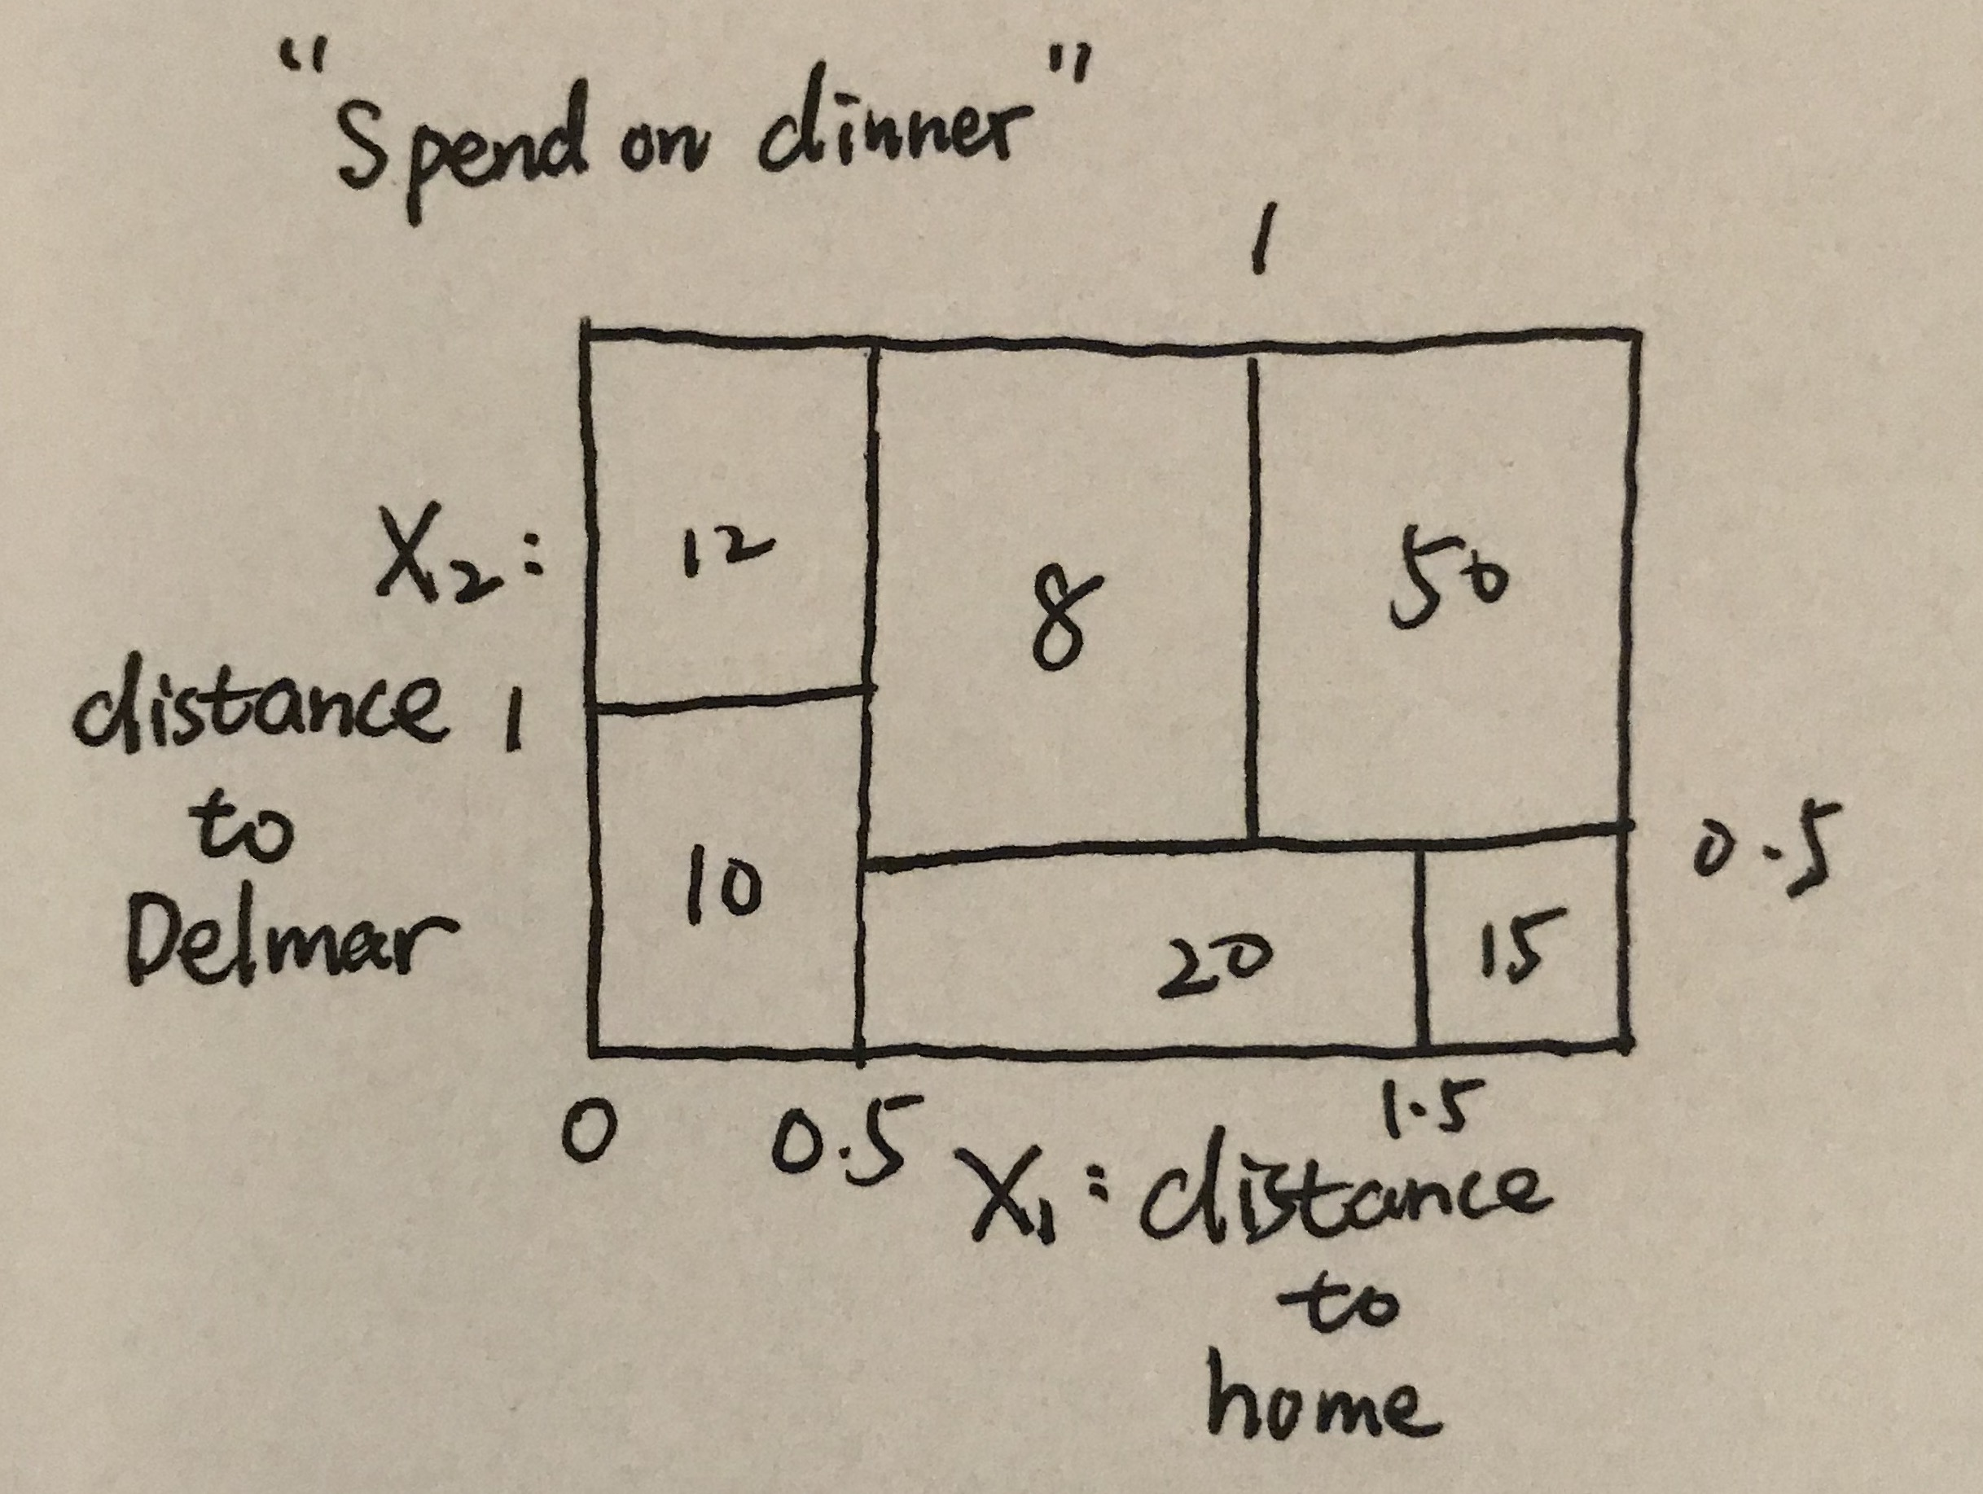
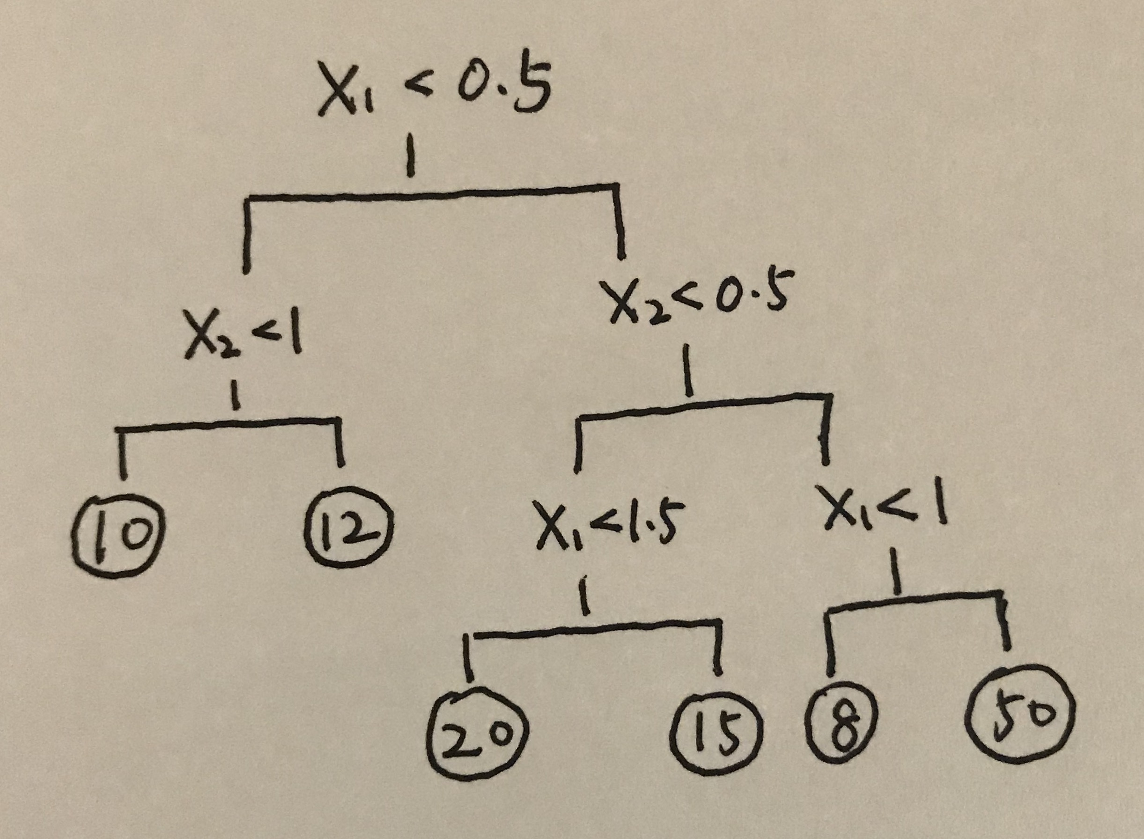
Exercise 8.4: Problems 1
At a given internal node, the label (of the form Xj < tk) indicates the left-hand branch emanating from that split, and the right-hand branch corresponds to Xj ≥ tk. (Your example should contain at least six regions. )
Notes:
Draw a decision tree corresponding to this partition.

Slide 6
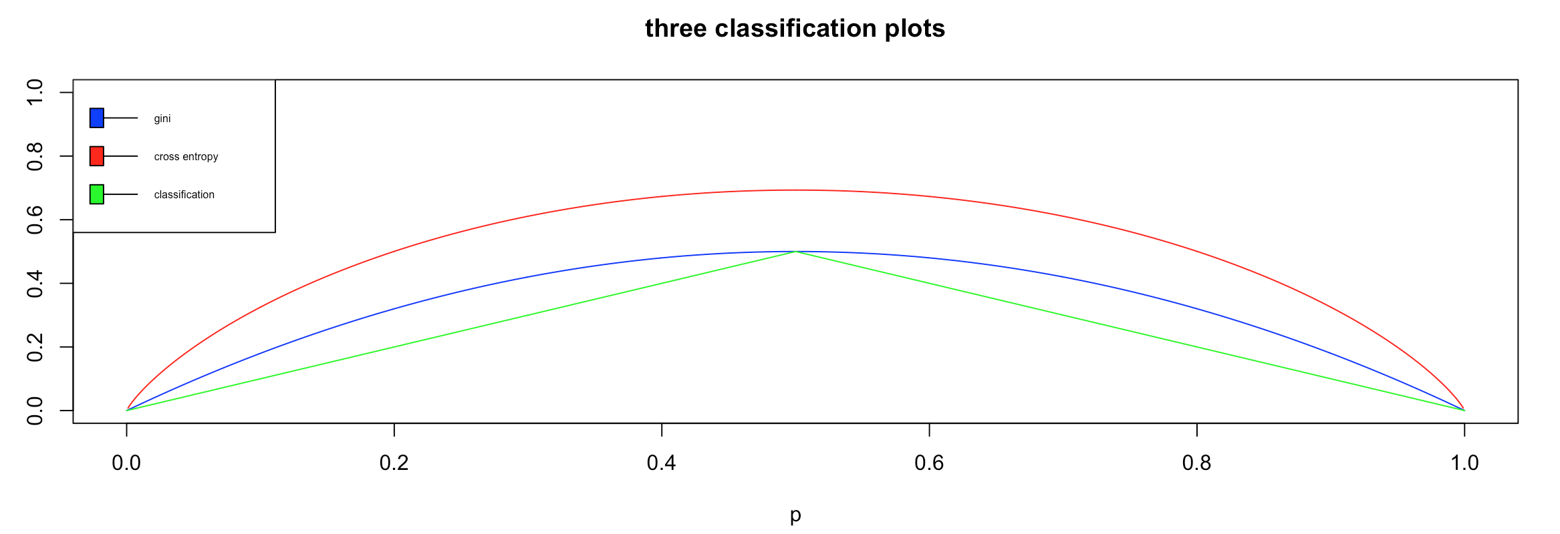
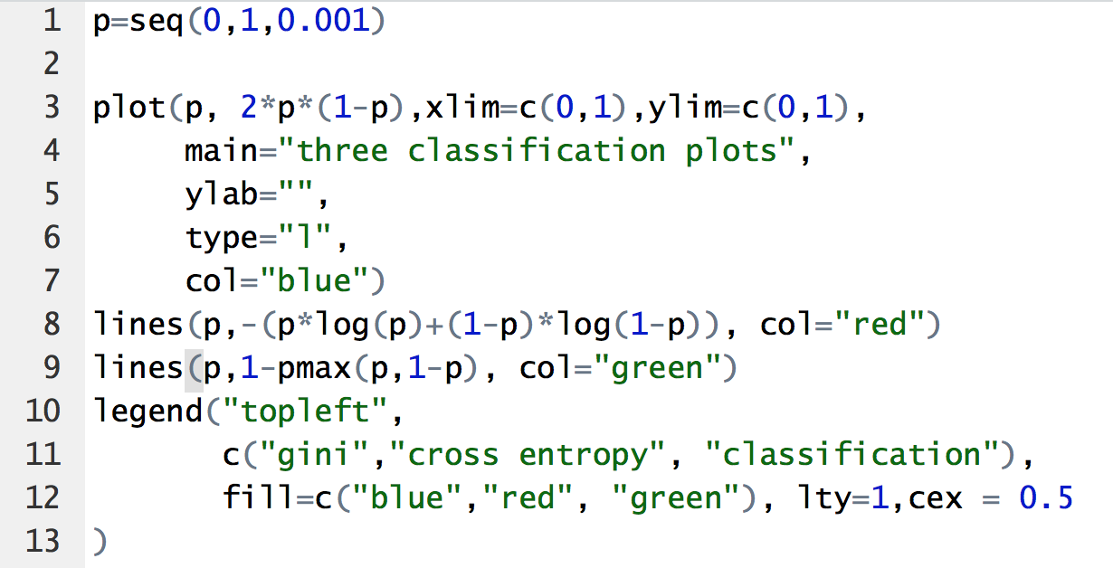

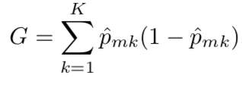

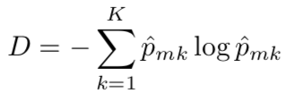

Exercise 8.4: Problems 3
Consider the Gini index, classification error, and entropy in a simple classification setting with two classes (k=2).
Substitute $p_{m2 }with{ p}_{m1}$
-> gini_index = 2* ${ p}_{m1}$*(1- ${ p}_{m1}$)
-> class_error = 1 – max (${ p}_{m1}$, 1 - ${ p}_{m1}$)
-> entropy = -$[{ p}_{m1}$*log(${ p}_{m1}$)+
(1- ${ p}_{m1}$)*log(1- ${ p}_{m1}$) ]
Notes:
Create a single plot that displays each of these quantities as a function of p ^ m 1. The x-axis should display p ^ m 1, ranging from 0 to 1, and the y-axis should display the value of the Gini index, classification error, and entropy.
In a setting with two classes, p ^ m 1 = 1 − p ^ m 2 You could make this plot by hand, but it will be much easier to make in R.

Slide 7
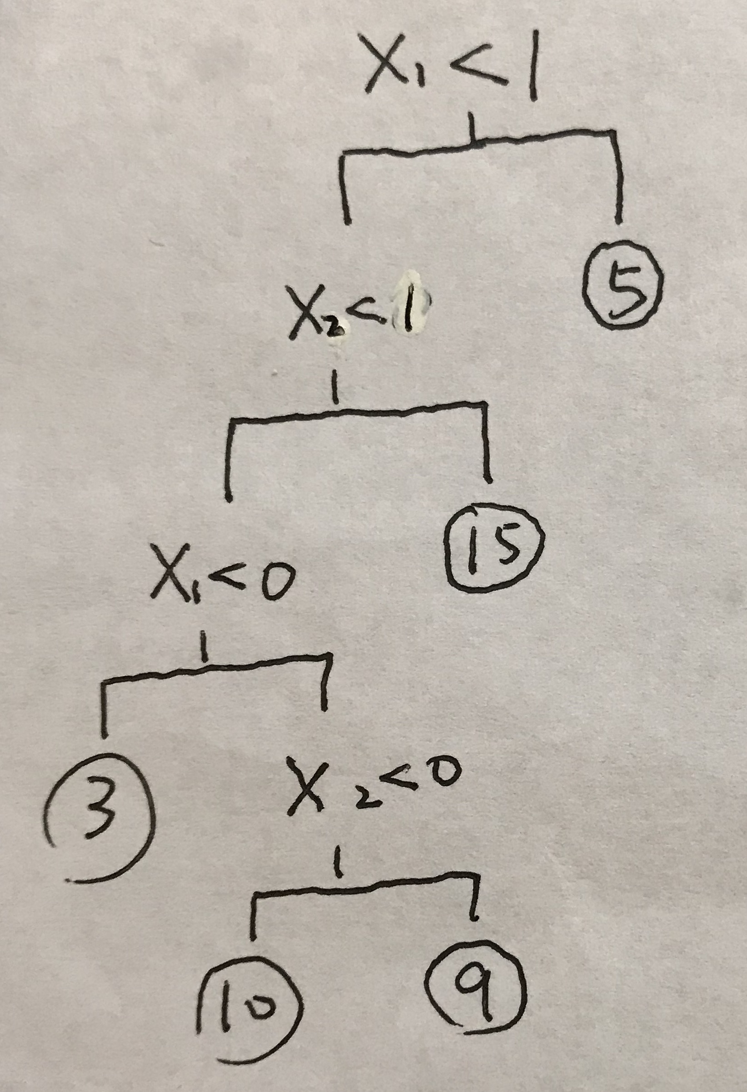
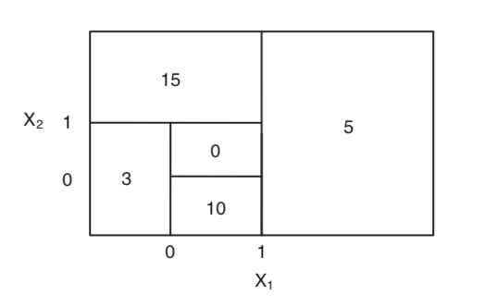
Exercise 8.4: Problems 4
(a) Sketch the tree corresponding to the partition of the predictor space illustrated in the left-hand panel of Figure 8.12. The numbers inside the boxes indicate the mean of Y within each region.

Slide 8
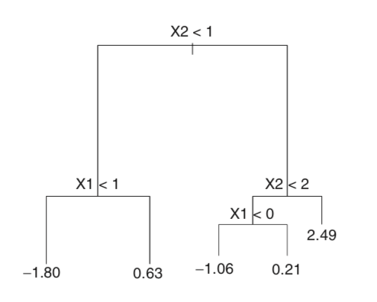
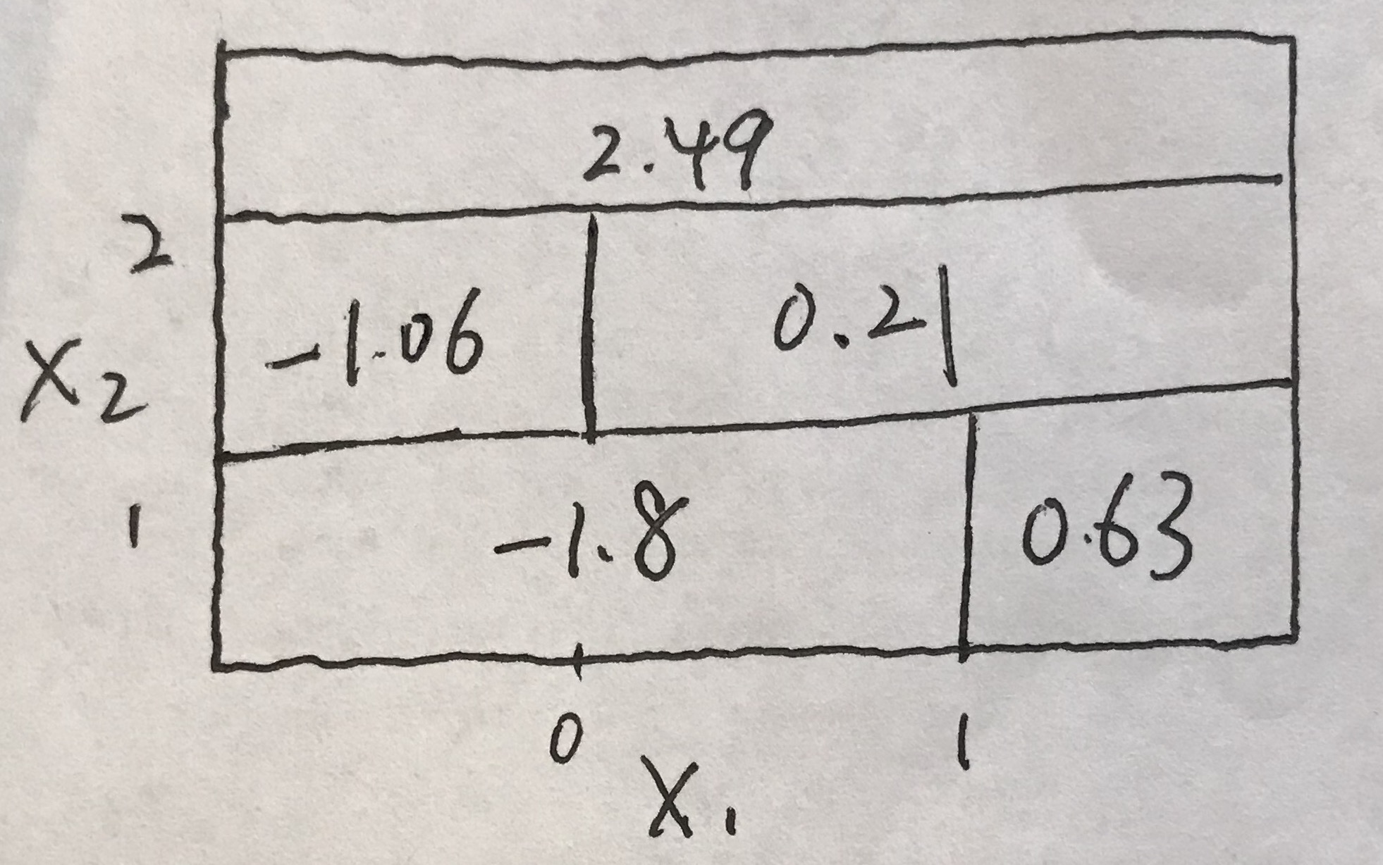
Exercise 8.4: Problems 4
(b) Create a diagram similar to the left-hand panel of Figure 8.12, using the tree illustrated in the right-hand panel of the same figure.

Slide 9
Group Assignment Exercise 8.4 Q9
(a) Create a training set
-> library (tree)
-> library (ISLR)
-> attach(OJ)
-> set.seed (2)
-> train=sample(1:nrow(OJ), 800)
-> OJ.train=OJ [train ,]
-> OJ.test=OJ [-train ,]

Slide 10
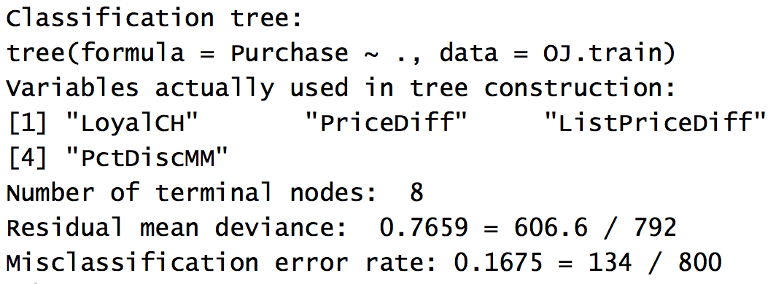
Group Assignment Exercise 8.4 Q9
(b) Fit a tree to the training data
-> tree.oj <- tree(Purchase ~ ., data = OJ.train)
The fitted tree has 8 terminal nodes and a training error rate of 0.1675.

Slide 11
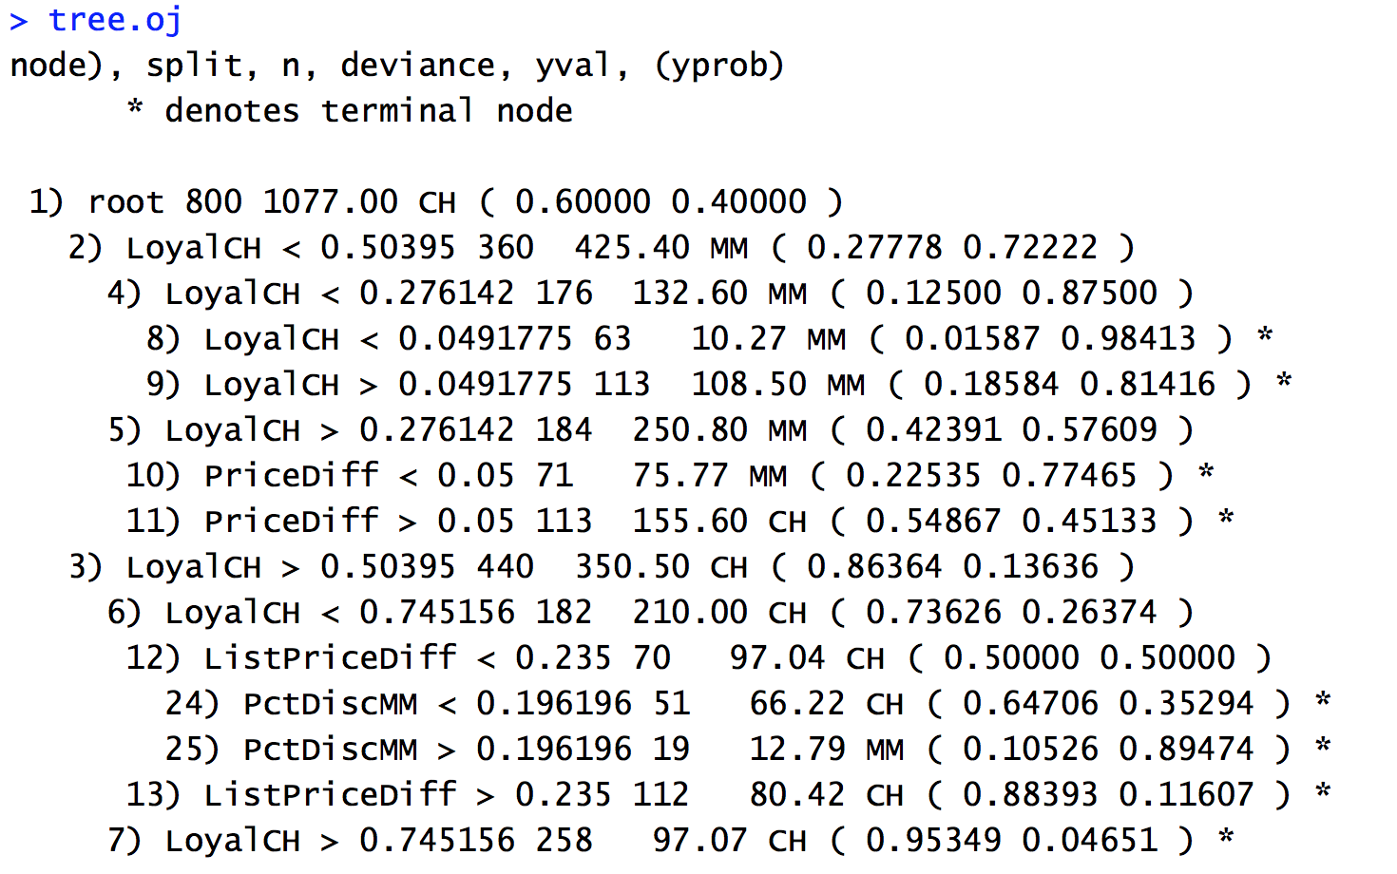
Group Assignment Exercise 8.4 Q9
(c)
Notes:
For example, node 11 “PriceDiff” is a terminal node. The node splits for “PriceDiff” > 0.05. There are 113 observation in the leaf with the residual deviance of 155.60. The overall
prediction is CH with 54.867% of observations taking CH value and rest 45.133% taking MM.

Slide 12
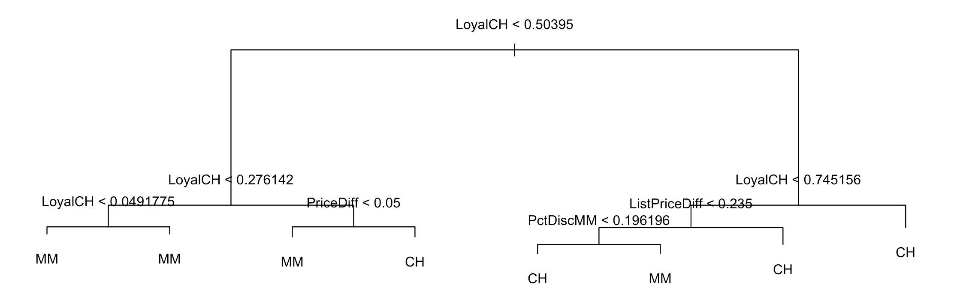
Group Assignment Exercise 8.4 Q9
(d) Plot and interpret the results
-> plot(tree.oj)
-> text(tree.oj, pretty=0)

Slide 13
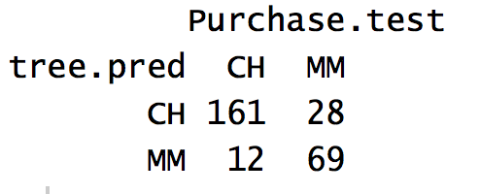
Group Assignment Exercise 8.4 Q9
(e) Predict and test error in confusion matrix
-> Purchase.test=Purchase[-train]
-> tree.pred=predict(tree.oj,OJ.test,type="class")
-> table(tree.pred ,Purchase.test)
-> mean(tree.pred !=Purchase.test)
-> 0.1481481

Slide 14
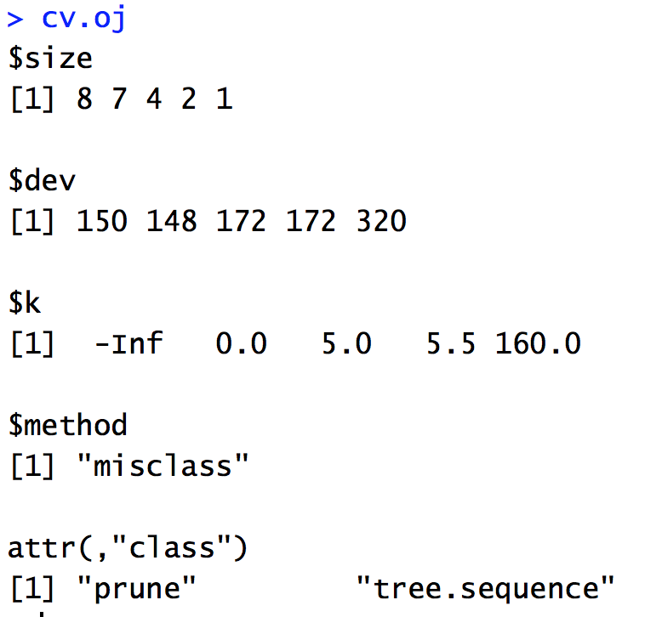
Group Assignment Exercise 8.4 Q9
(f)
-> cv.oj =cv.tree(tree.oj,FUN=prune.misclass )
Notes:
Note that, despite the name, dev corresponds to the cross-validation error rate in this instance. The tree with 7 terminal nodes results in the lowest cross-validation error rate, with 148 cross-validation errors.

Slide 15
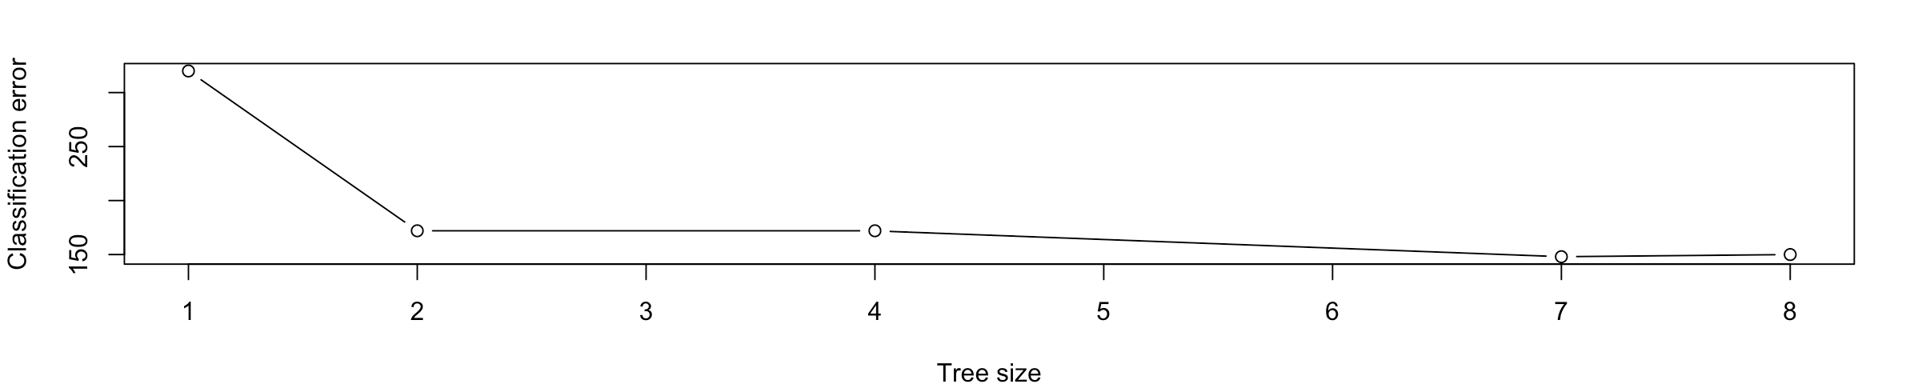
Group Assignment Exercise 8.4 Q9
(g) Produce a plot with tree size on the x-axis and cross-validated classification error rate on the y-axis.
-> plot(cv.oj$size, cv.oj$dev, type = "b", xlab = "Tree size", ylab = "Classification error")
(h) Which tree size corresponds to the lowest cross-validated classification error rate ?
The tree with 7 terminal nodes results in the lowest cross-validation error rate, with 148 as the error.

Slide 16
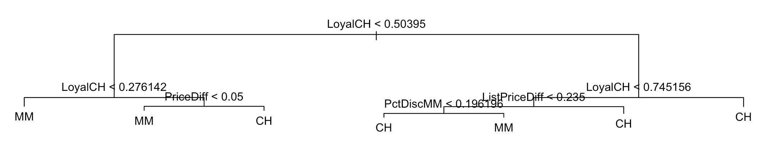
Group Assignment Exercise 8.4 Q9
(i) Produce a pruned tree corresponding to the optimal tree size obtained using cross-validation.
-> prune.oj=prune.misclass(tree.oj,best=7)

Slide 17
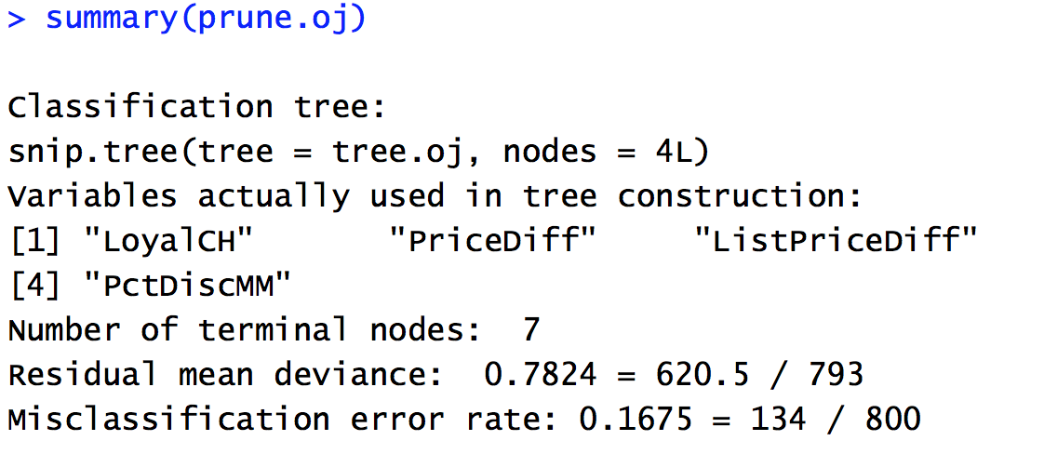
Group Assignment Exercise 8.4 Q9
(j) Compare the training error rates between the pruned and un- pruned trees. Which is higher?
-> summary (prune.oj)

Slide 18
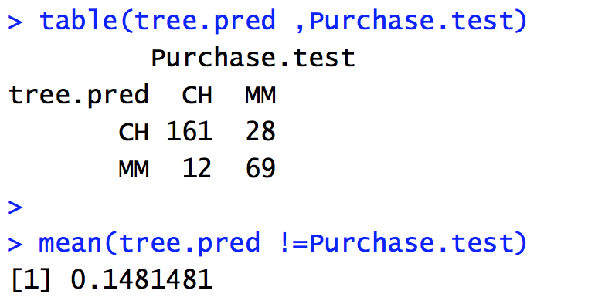
Group Assignment Exercise 8.4 Q9
(k) Compare the test error rates between the pruned and unpruned trees. Which is higher?
-> tree.pred=predict(prune.oj,OJ.test,type="class")
-> table(tree.pred ,Purchase.test)
In my case, the training and test errors for tree with and without pruning are the same.

